Slide 1
ABC Call Volume Trend Analysis
(Project – 8)
- BY HITISHA SONI

Slide 2
Project Description :-
In this project, you'll be diving into the world of Customer Experience (CX) analytics, specifically focusing on the inbound calling team of a company. You'll be provided with a dataset that spans 23 days.
A Customer Experience (CX) team plays a crucial role in a company. They analyze customer feedback and data, derive insights from it, and share these insights with the rest of the organization. This team is responsible for a wide range of tasks, including managing customer experience programs, handling internal communications, mapping customer journeys, and managing customer data, among others.
Inbound customer support, which is the focus of this project, involves handling incoming calls from existing or prospective customers. The goal is to attract, engage, and delight customers, turning them into loyal advocates for the business.

Slide 3
Approach :-
We have given a 1 dataset containing 1,17,988 rows.
Call_Data
Few columns are not important for analysis like:
Agent_Name
Agent_ID
Wrapped_By
Ringing
IVR_Duration

Slide 4

Tech-Stack Used:-

Slide 5
Tasks:
Link to Excel Sheet

Slide 6
1. Average Call Duration: Determine the average duration of all incoming calls received by agents. This should be calculated for each time bucket.
Your Task: What is the average duration of calls for each time bucket?

Slide 8
2. Call Volume Analysis: Visualize the total number of calls received. This should be represented as a graph or chart showing the number of calls against time. Time should be represented in buckets (e.g., 1-2, 2-3, etc.).
Your Task: Can you create a chart or graph that shows the number of calls received in each time bucket?

Slide 10
3. Manpower Planning: The current rate of abandoned calls is approximately 30%. Propose a plan for manpower allocation during each time bucket (from 9 am to 9 pm) to reduce the abandon rate to 10%. In other words, you need to calculate the minimum number of agents required in each time bucket to ensure that at least 90 out of 100 calls are answered.
Your Task: What is the minimum number of agents required in each time bucket to reduce the abandon rate to 10%?

Slide 11
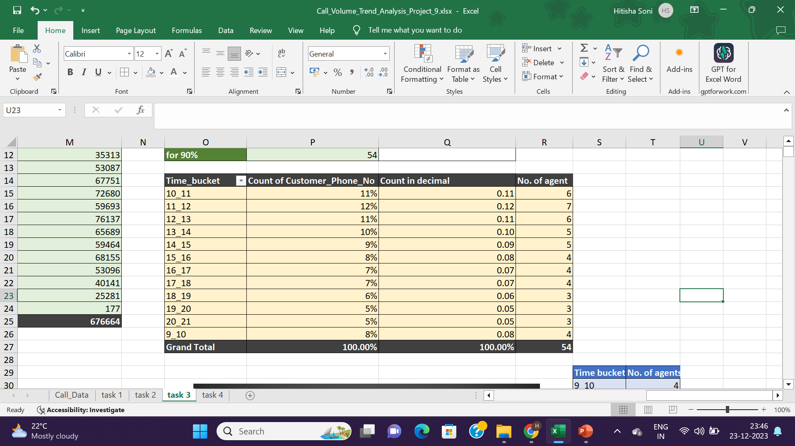

Slide 12
4. Night Shift Manpower Planning: Customers also call ABC Insurance Company at night but don't get an answer because there are no agents available. This creates a poor customer experience. Assume that for every 100 calls that customers make between 9 am and 9 pm, they also make 30 calls at night between 9 pm and 9 am. The distribution of these 30 calls is as follows:
Your Task: Propose a manpower plan for each time bucket throughout the day, keeping the maximum abandon rate at 10%.

Slide 13
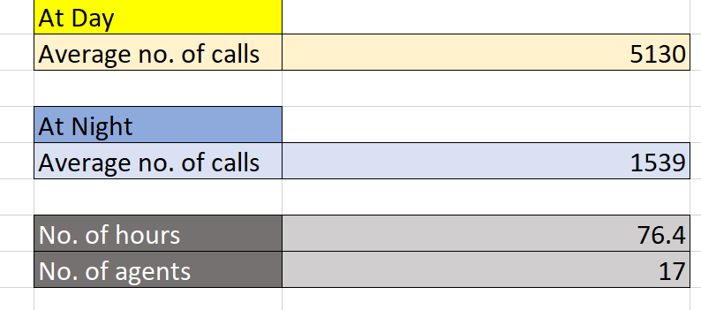
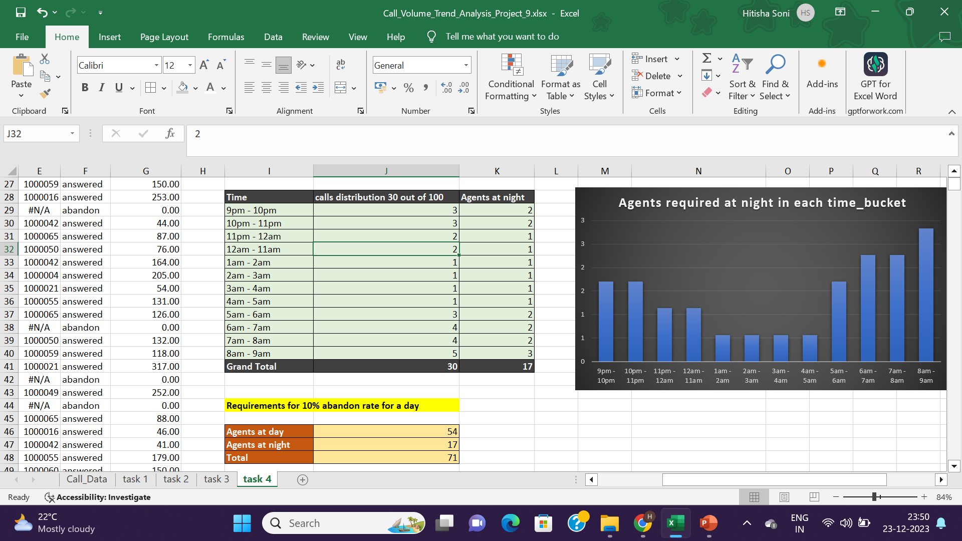

Slide 14
Result And Insights:
Average duration of calls in grand total is 03:19(hh:mm:ss) or 199 seconds.
Highest no. of calls were between 11am-12pm, that is, 14626 which is 12.40% of grand total.
The minimum number of agents required in Day in each time bucket to reduce the abandon rate to 10% is 54.
The minimum number of agents required in Night is 17.

Slide 15
Thank You

